Slide 1
Passengr
October 2017 PT Coding Bootcamp

Slide 2
Team
Jon Chan
Cecil Habermacher
Philip Harrell
Ryan Lee
Daniel Sullivan

Slide 3
About the Project

Slide 4
“Remember, no matter where you go, there you are…”
–Buckaroo Banzai

Slide 5
The Concept
Save a User-Defined List of Places
Display Information for Each
Location on Map
Time from Home
Nearby Restaurants

Slide 6
The Design Process

Slide 7
The Design Process
Brainstorm Concepts
Determine Features
Decide the APIs to Use
https://github.com/toddmotto/public-apis
https://github.com/abhishekbanthia/Public-APIs
Notes:
Brainstorm the concepts, then discuss via slack, then in-person.
Discussion was important for us, both in-person and via Slack.
Had many candidates for the APIs to use. Drew from https://github.com/toddmotto/public-apis and

Slide 8
The Design Process
Decide on the Framework to Use
Sketch the User Interface
Notes:
Decided to use Materialize for the framework. Reasons:
New framework, not boostrap. Experience, fun!
Liked the features that it gave us, especially the bottom-anchored modal.
Used Figma to collaborate on the user interface

Slide 9
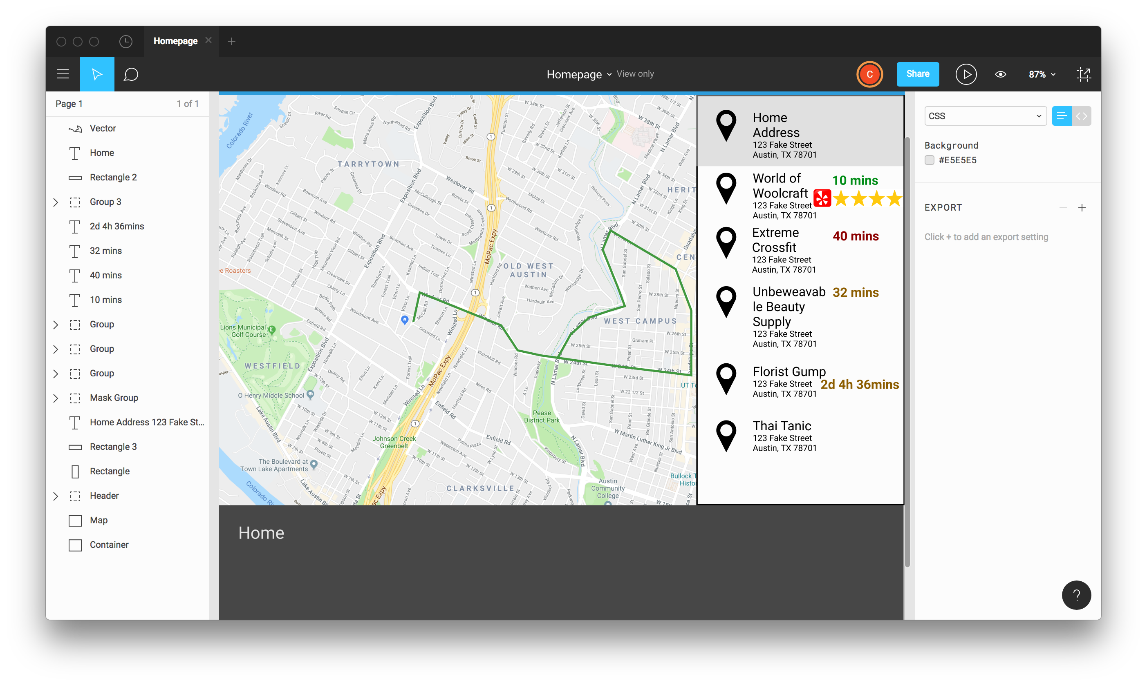

Slide 10
The Design Process
Discussed the Required Code
Divide the Tasks
Create the Project Proposal
Notes:
Brainstorm the concepts, then discuss via slack, then in-person.
Used Figma to collaborate on the user interface

Slide 11
Technologies
Materialize Framework
Google Map API
Zomato API
OpenWeather API
Firebase Database

Slide 12
Demo Time!
https://chabermacher.github.io/traveller-project/

Slide 13
Future Development
User Authentication
Music Player
Improve Firebase Data Storage
Add Map Routing
Add Interaction to Map Pins
Add a Build Process (Gulp or Grunt)

Slide 14
Lessons Learned
Communication is Key
Project Management is Actually Useful
Use a Priority List for Features
Prior Proper Planning Prevents…

Slide 15
Questions?

